Slide 1
JD+
Pre-processing step in Tramo and in X12/X13

Slide 2
Why pre-processing?
Exercise:
Effects of log/level, trading days, outliers on the final SA series (trend, irregular…)
Impacts using Tramo-Seats and X12-Arima
Airline models
Automatic model identification

Slide 3
Simplified schema
Initialization
Seasonality tests
Log/level
Regression (TD, Easter…)
Differencing
Arma identification
Outliers detection
Model checks
Final estimation

Slide 4
Implementation classes (I)
Module | Tramo | RegArima
Package | ec.tstoolkit.modelling.arima.tramo | ec.tstoolkit.modelling.arima.x13
Controller | TramoProcessor | X13Preprocessor
Initialization | TramoProcessor … | X13Preprocessor …
Log/level | LogLevelTest | LogLevelTest
Regression tests | RegressionVariableTest (legacy) RegressionTestTD (Wald test) RegressionTestTD2(F test) | X13Preprocessor.regAIC X13Preprocessor.checkMu
Outliers | OutliersDetector | OutliersDetector
Differencing | DifferencingModule | DifferencingModule
Arma | ArmaModule | ArmaModule

Slide 5
Implementation classes (II)
Module | Tramo | RegArima
Estimation | FinalEstimator | FinalEstimator
Controls | TramoProcessor … RegressionVariablesController RegressionVariablesTest2 SeasonalityController SeasonalOverDifferencingTest RegularUnderDifferencingTest SeasonalUnderDifferencingTest ModelBenchmarking | X13Preprocessor … ModelController RegressionVariablesTest

Slide 6
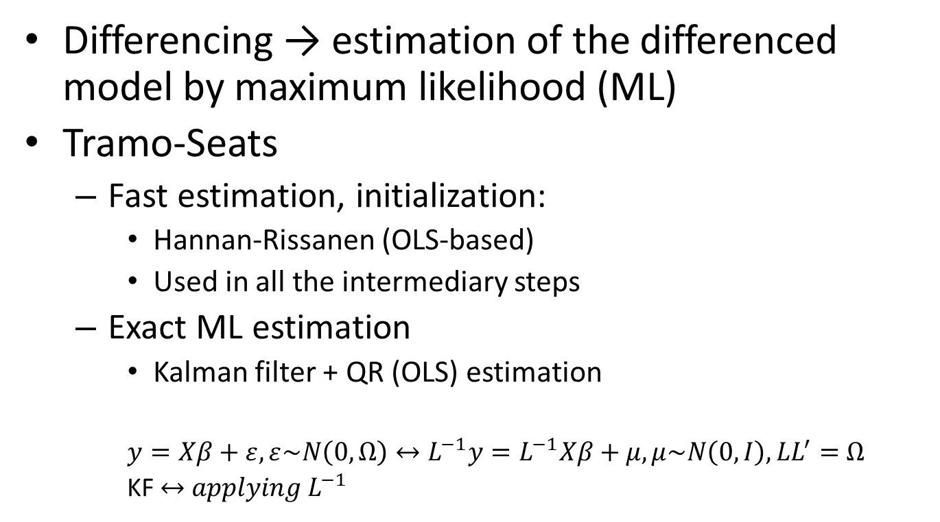
RegArima estimation
Differencing → estimation of the differenced model by maximum likelihood (ML)
Tramo-Seats
Fast estimation, initialization:
Hannan-Rissanen (OLS-based)
Used in all the intermediary steps
Exact ML estimation
Kalman filter + QR (OLS) estimation
$y=Xβ+ε, ε\sim N\left(0, Ω\right)↔L^{−1}y=L^{−1}Xβ+μ, μ\sim N\left(0, I\right), LL^{′}=$ $Ω$
KF $↔{ applying L}^{−1}$

Slide 7
RegArima estimation
X12-Arima
Exact ML estimation
Ljung-Box algorithm + QR (OLS) estimation
Tramo/X12
Same likelihood, different residuals
Tramo faster (even for ML estimation)
JD+
Always Tramo solution !

Slide 8
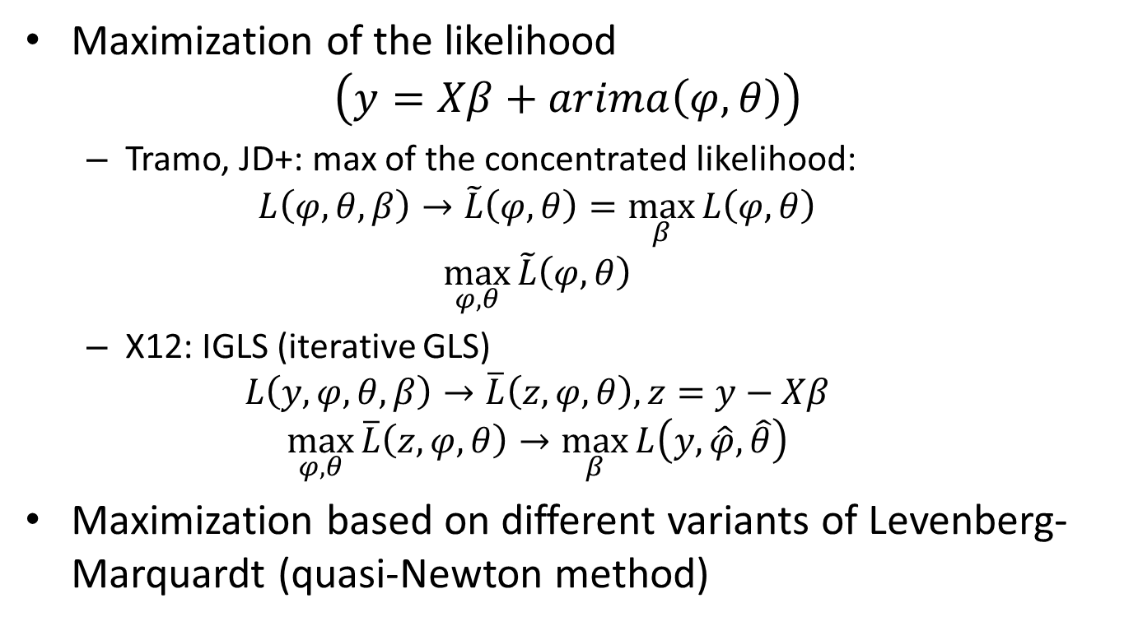
RegArima estimation
Maximization of the likelihood
$$\left(y=Xβ+arima\left(φ,θ\right)\right)$$
Tramo, JD+: max of the concentrated likelihood:
$$L\left(φ,θ,β\right)→\tilde{L}\left(φ,θ\right)=\max_{β}{L\left(φ,θ\right)}$$
$$\max_{φ,θ}{\tilde{L}\left(φ,θ\right)}$$
X12: IGLS (iterative GLS)
$$L\left(y, φ,θ,β\right)→\overline{L}\left(z, φ,θ\right), z=y−Xβ$$
$$\max_{φ,θ}{\overline{L}\left(z, φ,θ\right)}→\max_{β}{L\left(y,\hat{φ},\hat{θ}\right)}$$
Maximization based on different variants of Levenberg-Marquardt (quasi-Newton method)

Slide 9
Seasonality tests
Only in the last versions of Tramo and in JD+
Initial tests
Ljung-Box test: auto-correlations at seasonal lags
Correlations between (y(t), y(t-s)), (y(t), y(t-2*s))
Friedman (non parametric) test

Slide 10

Log-level test (I)
Tramo
SsqErr comparison
(fct)
Levels:
Airline+mean
Logs:
Airline+mean
Logs: SsqErr
*correction factor
$$SsqErr ∝likelihood$$
X13
AICC comparison
Levels:
Airline+mean[+regs…]
Logs:
Airline+mean[+regs…]
Logs: likelihood
+correction factor*
$$AICC=−2∙\left(loglikelihood−n∙np/(n−np−1)\right)$$

Slide 11
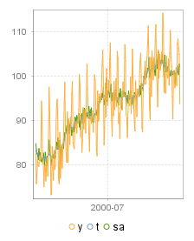
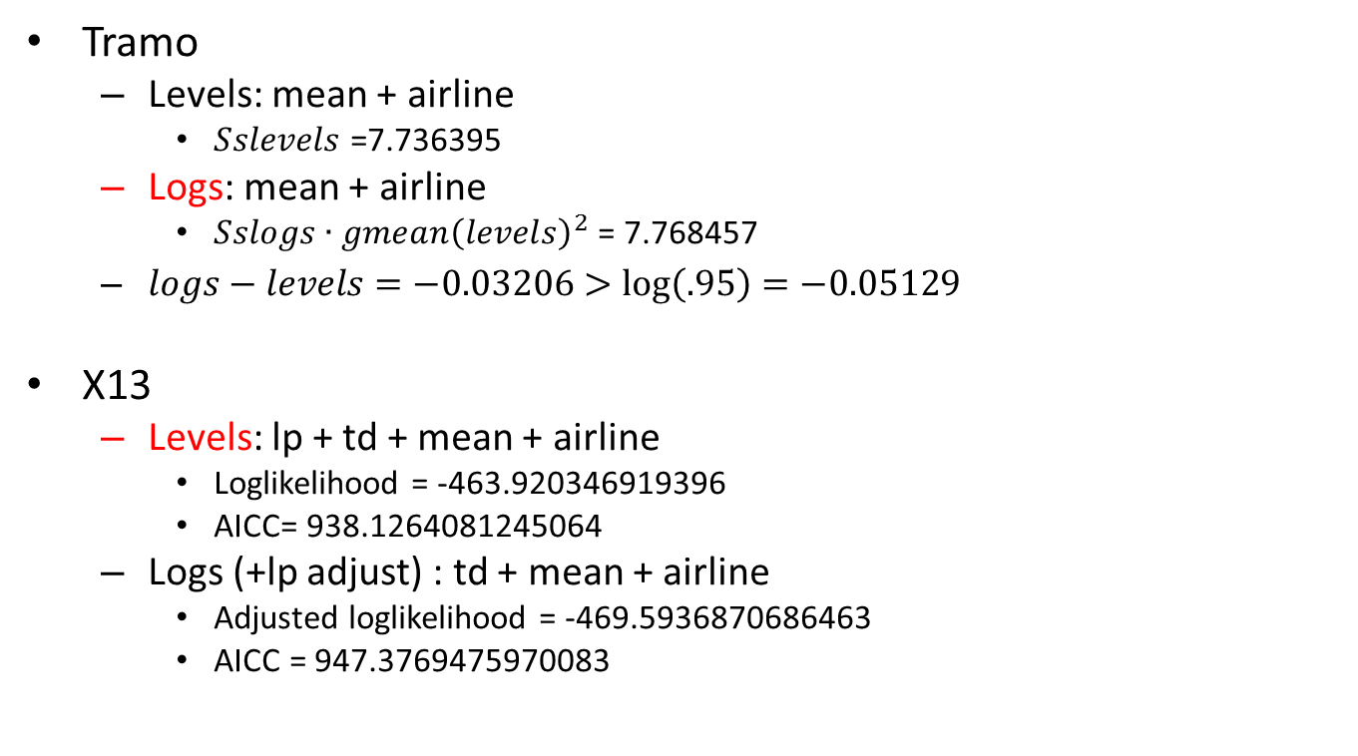
Log-level test (II)
Tramo
Levels: mean + airline
$Sslevels$ =7.736395
Logs: mean + airline
$Sslogs∙{gmean\left(levels\right)}^{2}$ = 7.768457
$logs−levels=−0.03206>\log\left(.95\right)=−0.05129$
X13
Levels: lp + td + mean + airline
Loglikelihood = -463.920346919396
AICC= 938.1264081245064
Logs (+lp adjust) : td + mean + airline
Adjusted loglikelihood = -469.5936870686463
AICC = 947.3769475970083

Slide 12

Regression (calendar) tests (I)
Tramo
Legacy code:
T-tests on trading days, leap year, Easter variable
New tests:
F-tests on trading/working days,
T-tests on trading days, leap year, Easter variable
JD+
Wald tests on trading/working days
See RegressionTestTD.java

Slide 13
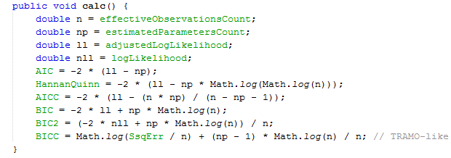
Regression (calendar) tests (II)
X12
AIC comparison between:
Models with and without trading days
Models with different Easter variables (length=1, 8, 15)
Models with other regression variables
See LikelihoodStatistics.java

Slide 14
Outliers detection
Types of outliers
AO, LS, TC, SO (SLS and IO not supported)
Impact of outliers
Estimated parameters
Forecasts…
Specific SA issues
Solutions
ML-based solutions
[Robust estimates]
Issues
Unstable algorithms
« Masking » effects

Slide 15
Outliers detection in Tramo
Model estimation
HR or ML
Computation of filtered residuals
OLS with « quasi » filtered outliers
No
Computation of robust T-Stats
Max T < VA
Remove 1 outlier
Yes
Model estimation
HR or ML
Add 1 outlier
Max T > VA
Yes
No
Remove less (<VA) significant outlier

Slide 16
Outliers detection in X12
Model estimation
By ML
GLS with all outliers (1 by 1)
Computation of robust T-Stats
Add 1 outlier (or all outliers)
Yes
Max T > VA
No
Remove less (<VA) significant outlier

Slide 17
Outliers detection. Key points
ML or HR estimation
Computation of robust stdev on the residuals
Regression on residuals or on complete models
Back calculation to identify masking effects
Exact or approximate GLS estimation

Slide 18
Differencing
Tramo ~ X12
Step 1:
Estimate (2 0 0)(1 0 0)+mean
Select root(s) : 1/|r| > initial UR (0.97)
Step 2:
Estimate (1 x 1)(1 y 1)+mean
Cancel similar AR, MA roots (cancel)
Select root(s) : 1/|r| > final UR (0.91)

Slide 19
ARMA identification
Tramo ~ X12
Computes BIC (Tramo-like) for different ARMA orders
Estimation of the models:
Tramo: Hannan-Rissanen
X12: exact ML
Best (acceptable) model selected

